Slide 1
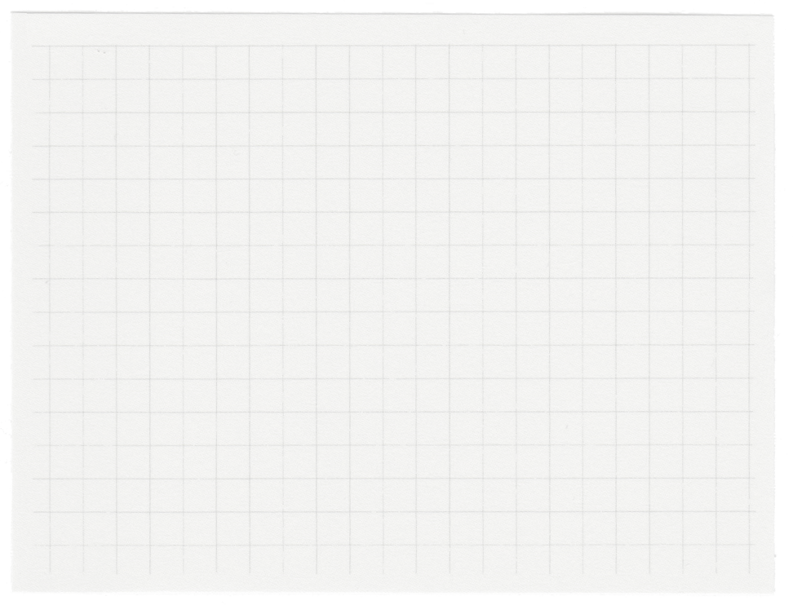







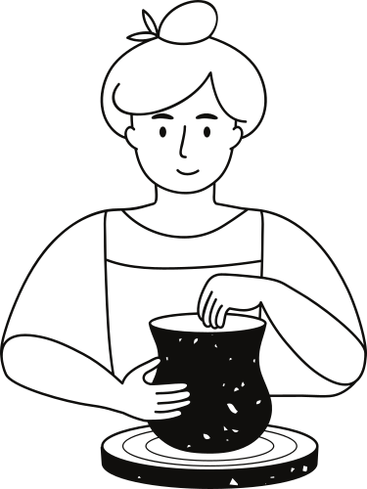






CytoAutoCluster
Enhancing Cytometry with Deep Learning
Presented by Stuti Dey

Slide 2
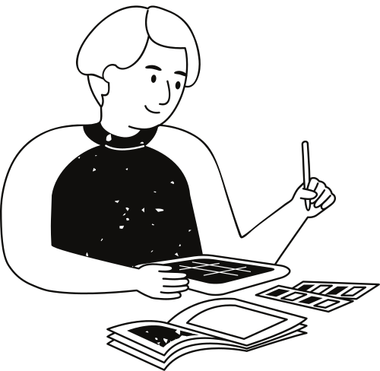
Problem Statement
1.Context: Cytometry produces large datasets with high dimensionality, making traditional clustering inefficient.
2.Challenges:
High dimensionality complicates data interpretation.
Limited labeled data restricts supervised learning models.
Biological variability introduces noise and inconsistency.
3.Objective:
Build a scalable framework to cluster high-dimensional cytometry data using semi-supervised learning techniques.
Reduce dependency on labeled data while improving clustering accuracy and interpretability.

Slide 3


Dataset Overview
01.
Dataset Overview: The dataset, Levine_32dim.csv, comprises 265,626 rows and 42 columns, containing cell markers like DNA1, DNA2, CD45RA, viability, and event numbers.
Data Preprocessing: The features were preprocessed using StandardScaler to standardize the data.
04.
Label Distribution: The dataset is partially labeled, with 39% of the data representing distinct cell populations and 61% unlabeled data.
Data Verification: The structure and dimensions of the dataset were verified to ensure data integrity.
02.
05.
Data Loading: The dataset was successfully loaded into a Pandas DataFrame for analysis.
Visualization: The label distribution was analyzed and visualized using bar charts for better understanding.
03.
06.

Slide 4
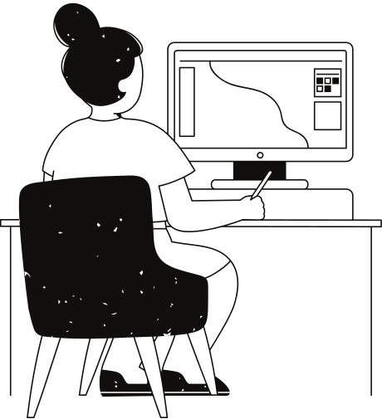
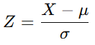
Methodology
1.Data Exploration:
Histograms and KDE plots to understand feature distributions.
Box plots to identify outliers.
Feature correlation using a heatmap.
2.Preprocessing:
Standardized data using z-score normalization:
Handled missing values and outliers.
Applied masking and corruption techniques to simulate realistic data.
3.Dimensionality Reduction:
PCA to identify principal components and retain maximum variance.
t-SNE for visualizing high-dimensional data in 2D space.

Slide 5
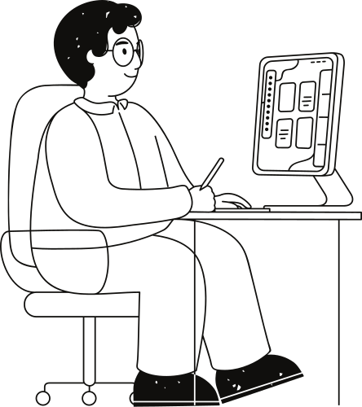
Model Details
1.Models Used:
Logistic Regression: A baseline model for classification.
XGBoost: For robust, gradient-boosted predictions.
2.Semi-Supervised Techniques:
Label Propagation: Assigned labels to unlabeled data by leveraging similarities.
Binary Masking: Simulated missing data.
Entropy Minimization: Reduced uncertainty in model predictions.
Consistency Regularization: Maintained stable predictions across augmented inputs.
3.Inputs from Code:
Labeled and unlabeled data separation.
Masking applied with a probability of 0.3.
4.Outputs from Code:
Improved label predictions for unlabeled data.
Masked and corrupted datasets ready for training.

Slide 6
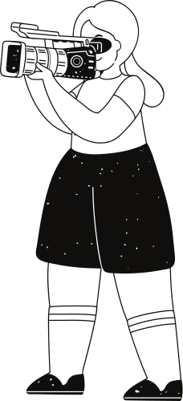
Generated Data Details
Masking
Shuffling
Introduced missing labels with a binary mask: Mask=Binomial(1,1−pm,shape)
Simulated missing data by combining original and shuffled datasets: Corrupted Data=(1−Mask)⋅Original Data+Mask⋅Shuffled Data
Independently shuffled each column to create variations.
Corruption
Outputs from Code
Combined original and shuffled data based on the mask.
Masked, shuffled, and corrupted datasets visualized and validated.

Slide 7
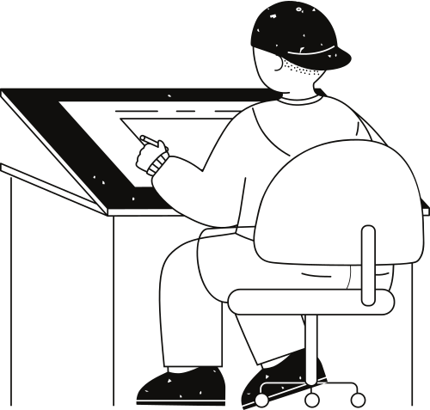
How the Model Works
01
02
03
04
05
06
Load high-dimensional cytometry data
Preprocess the data using standardization and dimensionality reduction
Apply semi-supervised learning techniques for label prediction
Logistic Regression and XGBoost are used as benchmark
Visualize clustering using t-SNE and PCA
Gradio Implementation

Slide 8
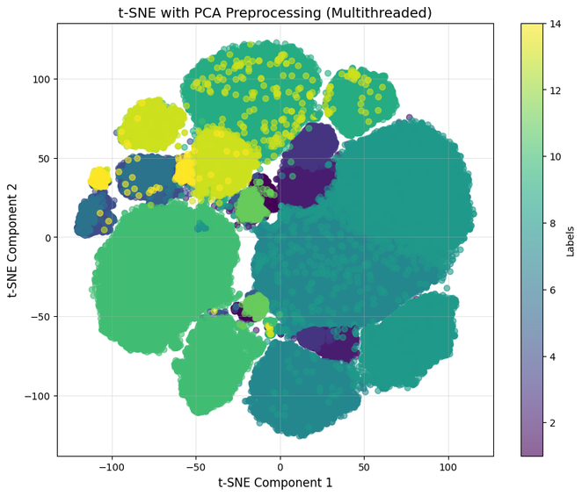
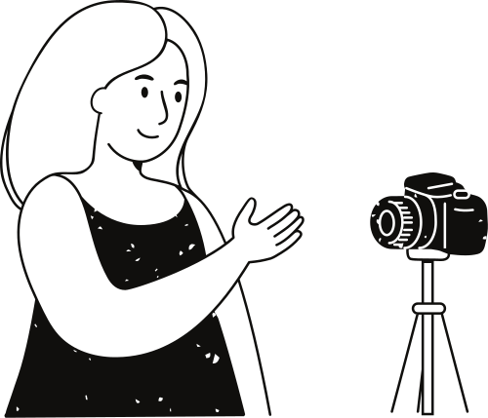
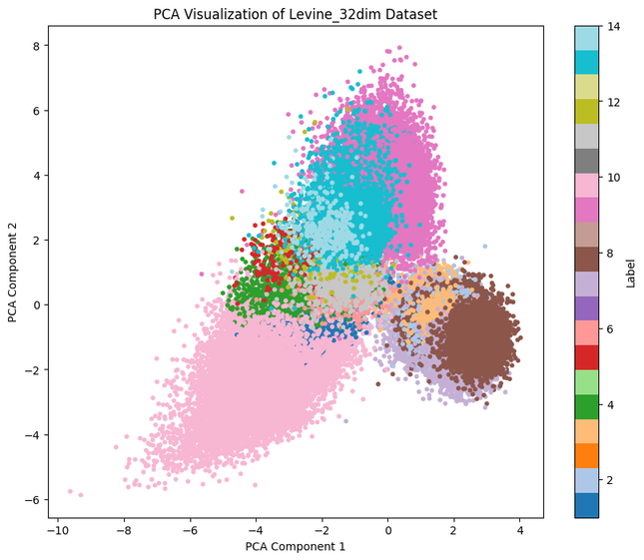
Output Visualizations
1.t-SNE Visualization:
Reduced data to two dimensions for cluster analysis.
Demonstrated separation between cell populations.
2.PCA Visualization:
Explained variance captured by top components.
Plotted clusters in 2D space.
3.Accuracy Metrics:
Silhouette Score: Measures cluster cohesion.
Purity Score: Evaluates cluster homogeneity.
Initial t-sne
PCA(2D Plot)

Slide 9
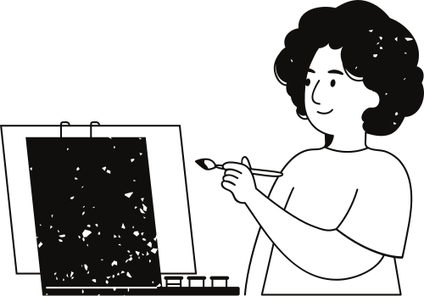
Future Directions
Incorporate advanced architectures .
Enable real-time clustering for live cytometry analysis.
Integrate the framework with existing biomedical systems.

Slide 10
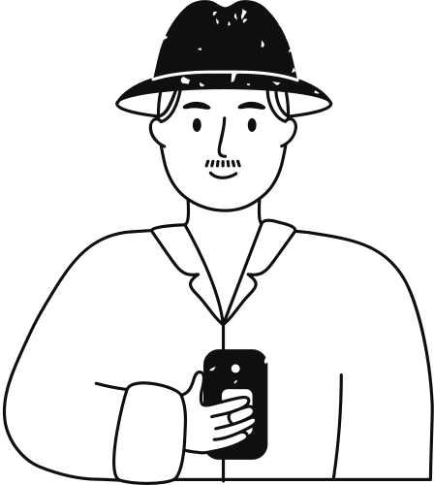
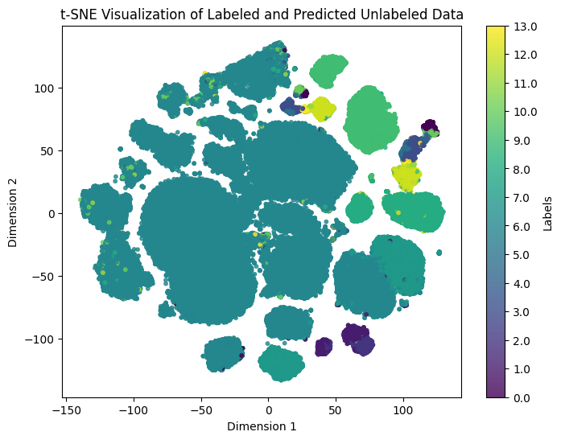
Results
Enhanced clustering accuracy through semi-supervised techniques.
Reduced dependence on labeled datasets.
Simplified high-dimensional noisy data analysis.
Delivered intuitive, interpretable cluster visualizations.
Modified t-sne plot

Slide 11
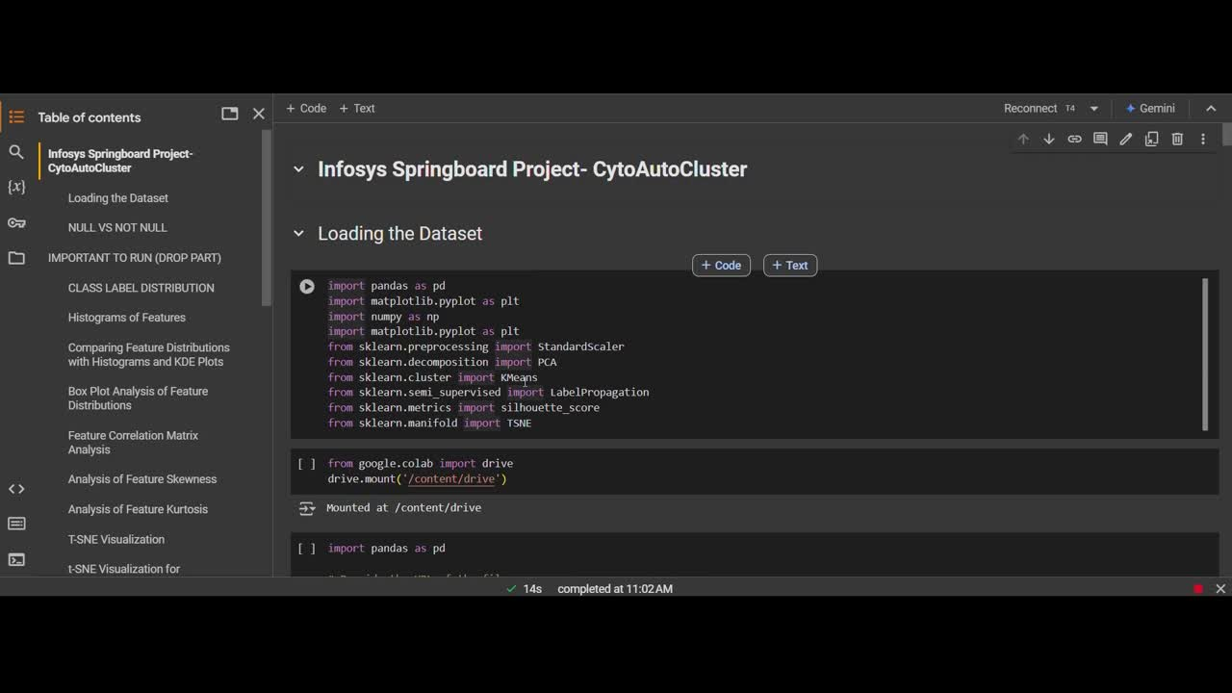
Demo Overview
1.Demo Workflow:
Load cytometry data and preprocess.
Apply masking and semi-supervised learning techniques.
Train models and visualize clusters.
2.Recording: https://drive.google.com/file/d/1JfEDPsJjt2oPdzipgL_7yQEMHVLD8Sr9/view?usp=drive_link

Slide 12
Thank you very much!

